Slide 1
Indexing
Strategies and Technicals

Slide 2
What is indexing? What do we use it for?
Indexing is a system level structure created for the purpose of speeding up read queries.
Indexes are created on tables using the columns as a sorting mechanism for the system to identify rows relevant to the search faster than searching the entire table.
Composite Index contains more than one column.
Covering Index contains all the columns that are in the executed query.

Slide 3
Indexing and Queries
Seek vs Scan
Table versus Index
Key Lookup
Heap, Leaf, Pages
Clustered vs non_clustered
Composite, Covering
Filtered Index

Slide 4
Seek versus Scan
Index Scan is nothing but scanning on the data pages from the first page to the last page. If there is an index on a table, and if the query is touching a larger amount of data, which means the query is retrieving more than 50 percent or 90 percent of the data, and then the optimizer would just scan all the data pages to retrieve the data rows. If there is no index, then you might see a Table Scan (Index Scan) in the execution plan.
Index seeks are generally preferred for the highly selective queries. What that means is that the query is just requesting a fewer number of rows or just retrieving the other 10 (some documents says 15 percent) of the rows of the table.
In general query optimizer tries to use an Index Seek which means that the optimizer has found a useful index to retrieve record set. But if it is not able to do so either because there is no index or no useful indexes on the table, then SQL Server has to scan all the records that satisfy the query condition.
Pinal Dave, SQL Authority.com
https://blog.sqlauthority.com/2007/03/30/sql-server-index-seek-vs-index-scan-table-scan/

Slide 5
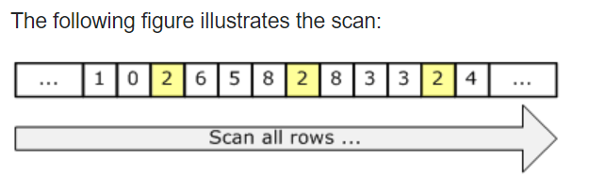

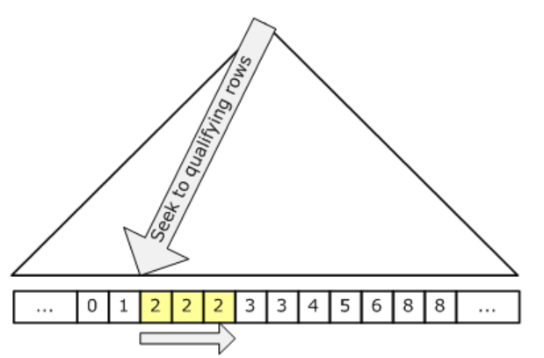
Walkthrough Explanation of Seek versus Scan
https://stackoverflow.com/questions/40486539/index-seek-vs-index-scan-in-sql-server

Slide 6
Key Look Up
This is an occurrence, not an operation.
It occurs when an index does not contain all the columns necessary to answer the query, so the system must go back and “look up.”
This condition is solved by creating a “covering index” to “include” additional columns – resulting in a “composite index.”
https://www.brentozar.com/blitzcache/expensive-key-lookups/
https://www.red-gate.com/simple-talk/sql/learn-sql-server/showplan-operator-of-the-week-bookmarkkey-lookup/

Slide 7
Look up tables vs (Temp tables, CTE, Cases)
https://bertwagner.com/2018/06/05/4-ways-to-define-lookup-values-in-a-query/
https://www.apress.com/gp/blog/all-blog-posts/best-practices-for-using-simple-lookup-tables/13323426

Slide 8
Clustered versus Non-Clustered
BLUF:
A clustered index can only have 1 column. So you should choose this column wisely. If you have no particular column you want to specify, then let SQL Server just default to the PK.
The significance of a non-clustered index is that it contains the columns you specify, AND the column from the clustered index – hence why you want to choose the clustered key wisely; the index acts as a pointer to the actual rows that meet the query.
https://www.techrepublic.com/article/index-on-multiple-columns-for-sql-performance/

Slide 9
Filtered Index
Filtered Index is used to index a portion of rows in a table.
It applies the filter on the INDEX which improves query performance, reduces index maintenance and index storage costs compared with full-table indexes.
Walkthrough examples:
https://www.red-gate.com/simple-talk/sql/performance/introduction-to-sql-server-filtered-indexes/
https://www.mssqltips.com/sqlservertip/1785/sql-server-filtered-indexes-what-they-are-how-to-use-and-performance-advantages/

Slide 10
Covering Index, Covered Query
Composite (sometimes called compound)
Hint
Include
Use index(Col_index)
With(index(index_name)

Slide 11
Covering
A Covering Index Includes all of the columns in the query you are executing.
A Covered Query means all the columns in the query are part of an index.

Slide 12
Include
Adding non-key columns to a non-clustered index to cover a query.
Because only key columns are contained in clustered indexes.
To increase coverage of a non-clustered index, additional non-key columns are included.
https://docs.microsoft.com/en-us/sql/relational-databases/indexes/create-indexes-with-included-columns?view=sql-server-2017

Slide 13
Hints
Hints are options specified for the query processor to execute for SELECT, INSERT, UPDATE, or DELETE statements.
The hints override any execution plan the query optimizer might select for a query and “forces” the specified option choices instead.

Slide 14
Chart of Hints
Table Hints
Options applied only to the table.
Query Hints
Options to be used throughout the query.
Remember Join Hints?
Merge,
Loop,
Hash
Index
Forcescan
Forceseek
Options:
Use
NoLock (read uncommitted)
Recompile

Slide 15
Recompile, “with recompile”
What is recompile?
Has the effect of “clearing the cache” of the execution plan for the query or SPROC.
Why should I use it?
Performance and tuning. When I think the execution plan needs to be refreshed, or to force a change in the plan.

Slide 16
Creating plan guides: Table Hint Index
EXEC sp_control_plan_guide N'DROP ALL'
EXEC sp_create_plan_guide
@name = N'Guide1',
@stmt = N'SELECT c.LastName, c.FirstName, e.Title
FROM HumanResources.Employee AS e
JOIN Person.Contact AS c ON e.ContactID = c.ContactID
WHERE e.ManagerID = 2;',
@type = N'SQL',
@module_or_batch = NULL,
@params = NULL,
@hints = N'OPTION (TABLE HINT(e, INDEX (IX_Employee_ManagerID)))';
EXEC sp_create_plan_guide
@name = N'Guide2',
@stmt = N'SELECT c.LastName, c.FirstName, e.Title
FROM HumanResources.Employee AS e
JOIN Person.Contact AS c ON e.ContactID = c.ContactID
WHERE e.ManagerID = 2;',
@type = N'SQL',
@module_or_batch = NULL,
@params = NULL,
@hints = N'OPTION (TABLE HINT(e, INDEX(PK_Employee_EmployeeID, IX_Employee_ManagerID)))';

Slide 17
Creating plan guides: Table Hint Forceseek
EXEC sp_create_plan_guide
@name = N'Guide3',
@stmt = N'SELECT c.LastName, c.FirstName, HumanResources.Employee.Title
FROM HumanResources.Employee
JOIN Person.Contact AS c ON HumanResources.Employee.ContactID = c.ContactID
WHERE HumanResources.Employee.ManagerID = 3
ORDER BY c.LastName, c.FirstName;',
@type = N'SQL',
@module_or_batch = NULL,
@params = NULL,
@hints = N'OPTION (TABLE HINT( HumanResources.Employee, FORCESEEK))';

Slide 18
Table Hint Forcescan vs Forceseek
SELECT h.SalesOrderID, h.TotalDue, d.OrderQty
FROM Sales.SalesOrderHeader AS h
INNER JOIN Sales.SalesOrderDetail AS d
WITH (FORCESEEK (PK_SalesOrderDetail_SalesOrderID_SalesOrderDetailID (SalesOrderID)))
ON h.SalesOrderID = d.SalesOrderID
WHERE h.TotalDue > 100 AND (d.OrderQty > 5 OR d.LineTotal < 1000.00);
SELECT h.SalesOrderID, h.TotalDue, d.OrderQty
FROM Sales.SalesOrderHeader AS h
INNER JOIN Sales.SalesOrderDetail AS d
WITH (FORCESCAN)
ON h.SalesOrderID = d.SalesOrderID
WHERE h.TotalDue > 100 AND (d.OrderQty > 5 OR d.LineTotal < 1000.00);

Slide 19
Heap, Leaf, Page: Remember architecture from Week 1?
Heap: Describes storage format of a table without a clustered index.
A heap stores data in a structure without an specified order.
One or more non-clustered indexes on a table are stored as heaps.
Think S-H-I-T: Stored Heap of Information about a Table.
Leaf: The lowest level of the index.
At the leaf level, the index contains a key value for each row in the table;
In a clustered index the rows are stored in sorted order; the leaf is the data.
Page: Lowest level of store structure: Index page, Data page.
Detailed explanation of page structures:
https://sqlhints.com/2018/05/05/how-to-inspect-the-content-of-a-data-page-or-index-page-tip-6-sql-server-101-performance-tuning-tips-and-tricks/

Slide 20
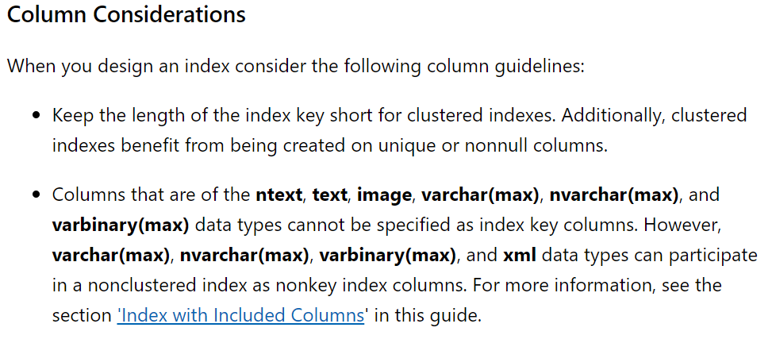
Remember: Why did you choose this data type?
https://docs.microsoft.com/en-us/sql/relational-databases/sql-server-index-design-guide?view=sql-server-2017

Slide 21
Practical Application: Why is this important to know?
If a table is a heap and does not have any non-clustered indexes, then the entire table must be examined (table scan) to find any row.
Because a heap structure in not ordered, this will impact performance if you need your data sorted for your queries.
This is why you may need to choose a clustered index.
This is also why you need to understand the difference between scan and seek, when you see it come up in the execution plans.

Slide 22
Table scan versus Index scan
Table scan searches all rows of all columns in the entire table.
Index scan searches all rows of the indexed columns of the entire table.
See the difference?
Cluster index rows are sorted.
Non-clustered index rows are not sorted.
See the difference?
https://dzone.com/articles/there-any-differences-between

Slide 23
Index Options
https://docs.microsoft.com/en-us/sql/t-sql/statements/alter-table-index-option-transact-sql?view=sql-server-2017
PAD_INDEX = { ON | OFF }
| FILLFACTOR = fillfactor
| IGNORE_DUP_KEY = { ON | OFF }
| STATISTICS_NORECOMPUTE = { ON | OFF }
| ALLOW_ROW_LOCKS = { ON | OFF }
| ALLOW_PAGE_LOCKS = { ON | OFF }
| OPTIMIZE_FOR_SEQUENTIAL_KEY = { ON | OFF }
| SORT_IN_TEMPDB = { ON | OFF }
| ONLINE = { ON | OFF }
| MAXDOP = max_degree_of_parallelism
| DATA_COMPRESSION = { NONE |ROW | PAGE | COLUMNSTORE | COLUMNSTORE_ARCHIVE }
[ ON PARTITIONS ( { <partition_number_expression> | <range> }
[ , ...n ] ) ]
| ONLINE = { ON [ ( <low_priority_lock_wait> ) ] | OFF }

Slide 24
Indexing Skills Review
PK, clustered, non_clustered
Unique, non_unique
Single Column, Composite
Filtered
Covering, Covered
Table, Query Hint
Include, Use, With
Options
No lock, read past
Tuning

Slide 25
Clustered/Non-Clustered, Covered Index/Query Walkthrough Examples
https://www.red-gate.com/simple-talk/sql/learn-sql-server/using-covering-indexes-to-improve-query-performance/
https://www.mssqltips.com/sqlservertip/3511/sql-server-covering-index-performance/

Slide 26
Index Performance Analysis Walkthrough
https://www.mssqltips.com/sqlservertip/2045/using-hints-to-test-sql-server-indexes/

Slide 27
Tuning Exercise
Create separate tables with the following configurations:
No index
PK index
Non PK clustered index
Both Clustered Index and non-clustered Index
Only a Non-clustered index
Composite index (can only be non-clustered)
Create Execution plans using table, query hints
Analyze performance of Index Choices and Choices of Hints
Demonstrate use of: Composite, Covering, Use, Include, With, Filter

